Slide 1
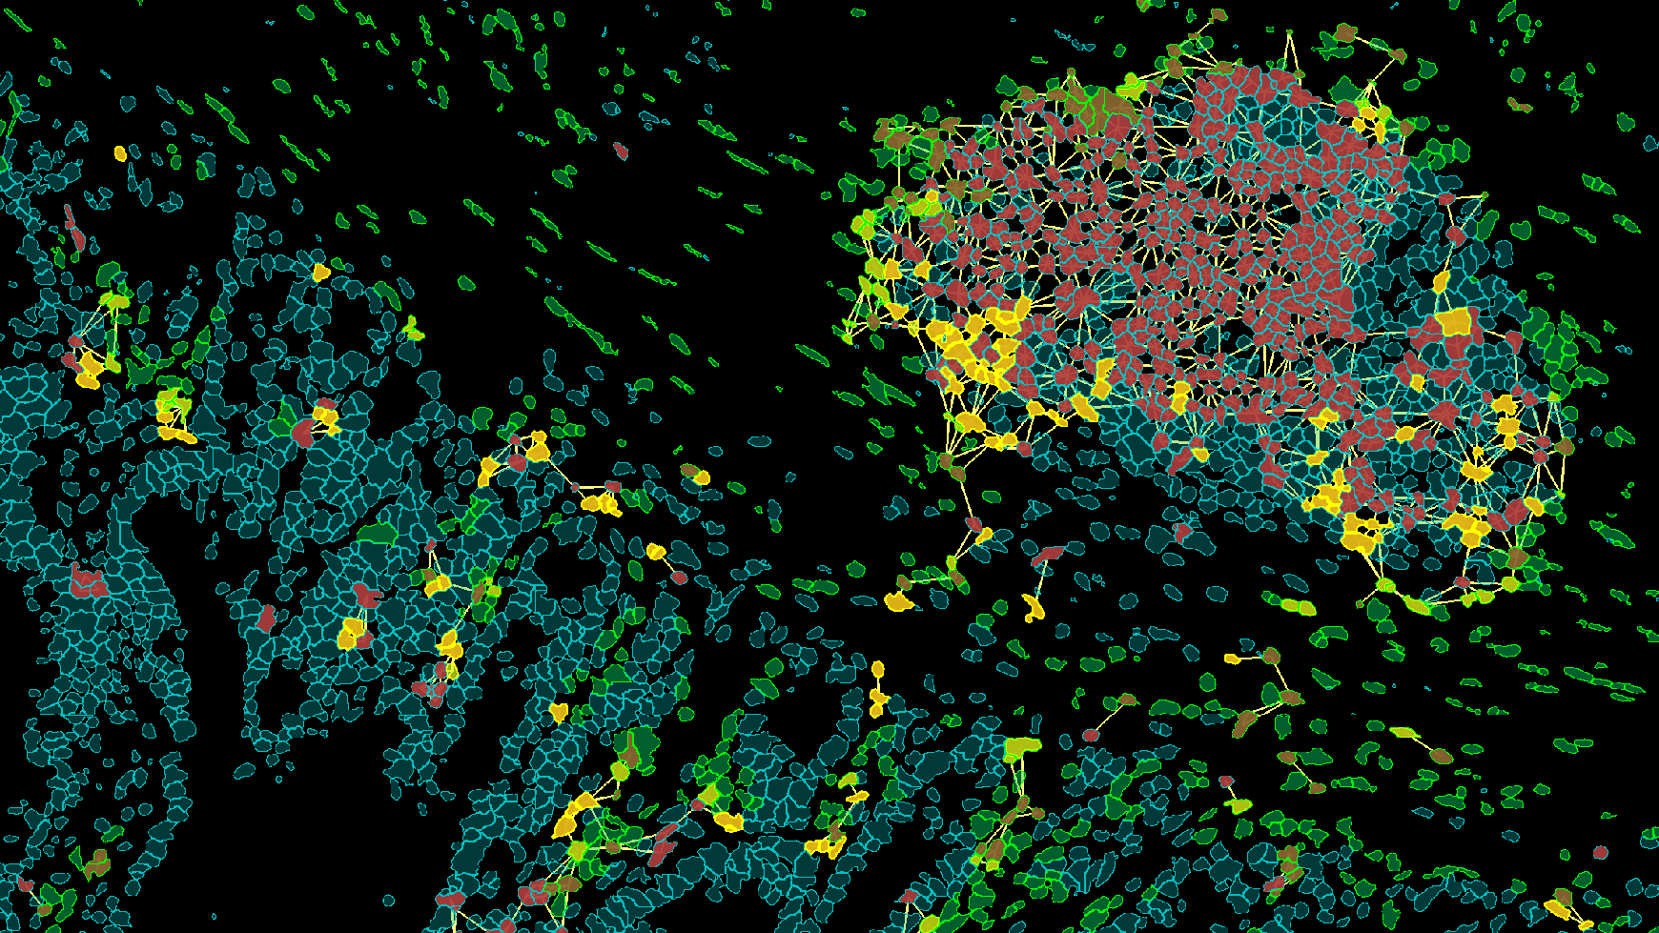
“TISSUE CYTOMETRY WORKSHOP”. Place: IQ-USP, Anfiteatro1 Queijinho.
(16.03-18.03.2022)
Date
Wednesday, 16 March 2022 | 10-11am | Opening Lecture: ' Tissue Cytometry' by Prof. Henning Ulrich, Instituto de Quimica Universidade de Sao Paulo;
Wednesday, 16 March 2022 | 2-3pm | Dr. Felicitas Mungenast . “The many faces of tissue cytometry”
Wednesday, 16 March 2022 | 3-4pm | Prof. Nicolas Hoch. “Quantification of fluorescence microscopy images: focus on the foci!”
Thursday, 17 March 2022 | 9am-5pm | 5x 2 Person groups "hands on" TissueFax or TissueQuest/HistoQuest for 1 hour each group (9-10am, 10:30-11:30am, 1-2pm, 2:30-3:30pm, 4-5pm). Dr. Felicitas Mungenast, Mike Etrich, B.Eng., Prof. Henning Ulrich, Dr. Talita Glaser
Friday, 18 March 2022 | 9am-5pm | 5x 2 Person groups "hands on" TissueFax or TissueQuest/HistoQuest for 1 hour each group (9-10am, 10:30-11:30am, 1-2pm, 2:30-3:30pm, 4-5pm). Dr. Felicitas Mungenast, Mike Etrich, B.Eng., Prof. Henning Ulrich, Dr. Talita Glaser
Step 3: Proximiy Measurements
Registrations at talita.glaser@usp.br until 14.03.22
Powered by
&
by Instituto de Quimica Universidade de Sao Paulo, Brazil

